Slide 1

Mobile Robot for Smart Restaurants
Group Members:
Muneeb Ahmad
Ahmed Saeed
Mohib Ahmed
Muhammad Zakriya
Supervisor:
Dr. Uzair Khaleeq uz Zaman
Co-Supervisors:
Dr. Anas Bin Aqeel
A/P Kanwal Naveed

Slide 2



Objective
To Design & Construct a Mobile Line Following Robot that Can Automate the Job of a Waiter In a Restaurant Environment

Slide 3
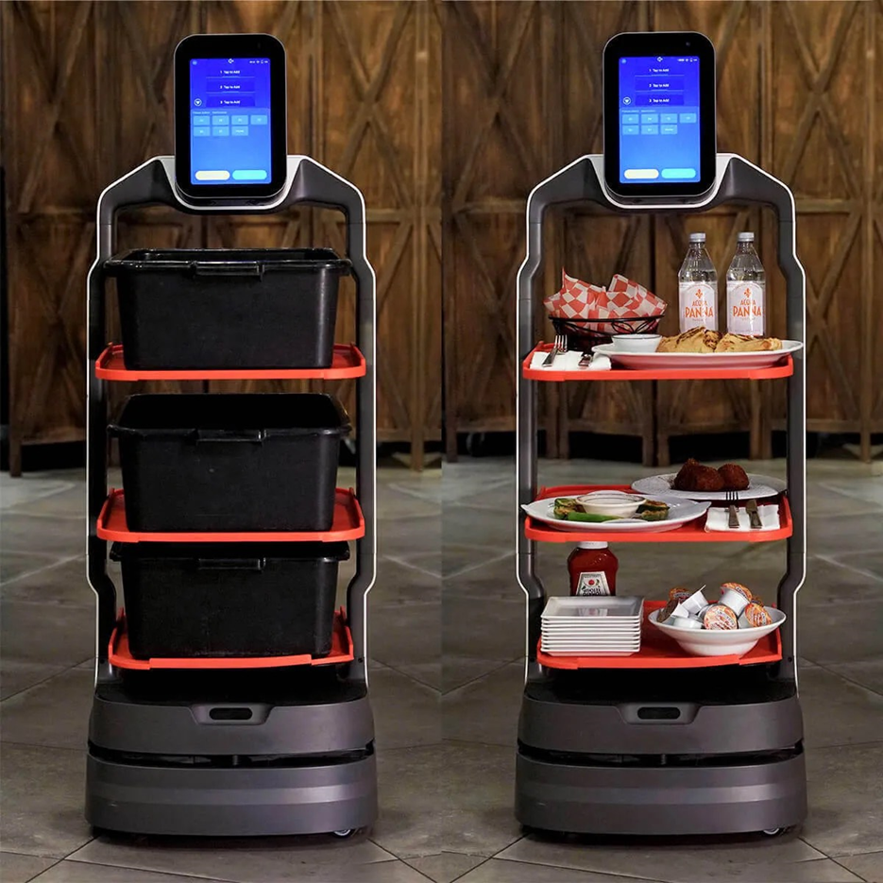

The Problem
3.5 Trillion USD Global Restaurant Industry ^{[1]}
Labor Shortages^{[2]} - Prime Target for Automation
Opportunities to Reduce Cost and Increase Profits^{[3]}
Improved Customer Experience^{[4]}
Ordering, Payment & Serving are the Easiest & Most Beneficial to Automate

Slide 4
Project Deliverables
Design & Build a Mobile Line Following Robot that is Able to Follow the Shortest path to a Destination (tables) and Avoid Collisions
1
Make it Capable of Carrying Load (Food & Drinks) without Spilling Them Using Quick Interchangeable Carrying Trays
2
Make it IoT Enabled so it can Send and Receive Data to and from Restaurant Staff
3
Ensure Ecosystem Integrability Through Software & Hardware Design as well as Industry Level Documentation
4

Slide 5
Additional Accomplishments
Built An Ecosystem of Apps (Ordering, FoH Display, Remote Control) to Work Alongside the Robot as VAS
5
Studied Velocity, Acceleration & Braking Profiles to Ensure Robot Movement & Trajectory is Smooth and Safe
6
Used Cameras for Navigation Instead of a Sensor Based Approach; Enabled Robot to Map and Store the Restaurant Layout
7
Created a cloud Database for Restaurants to Digitize their Menus & Collect Valuable Trend Data
8

Slide 6
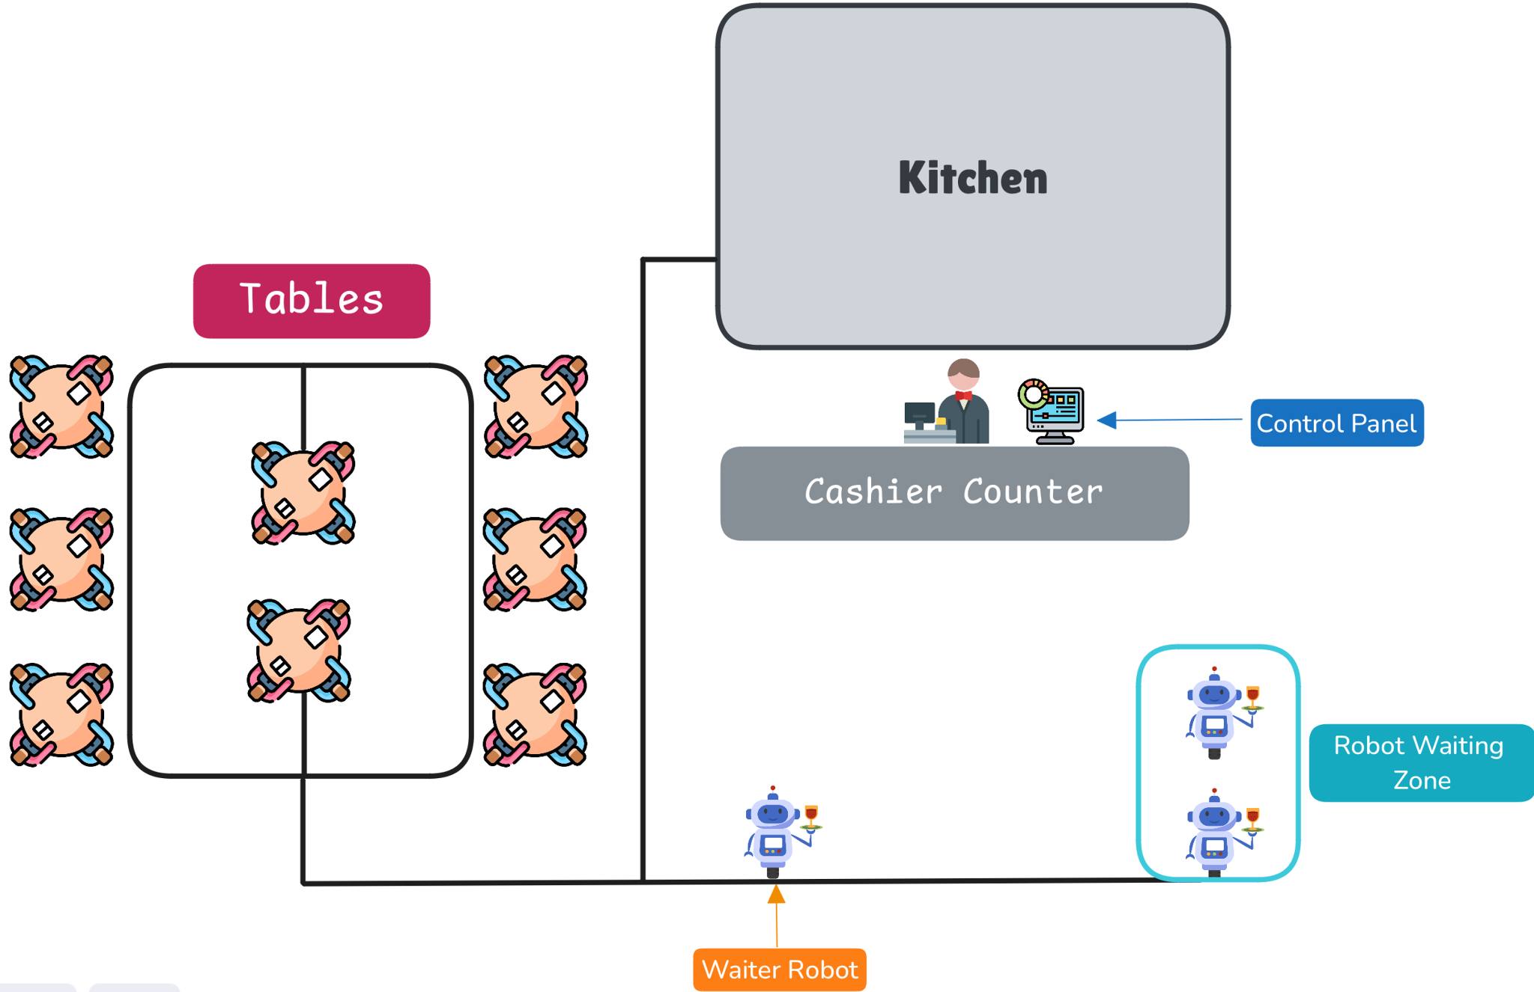
Representative Environment

Slide 7
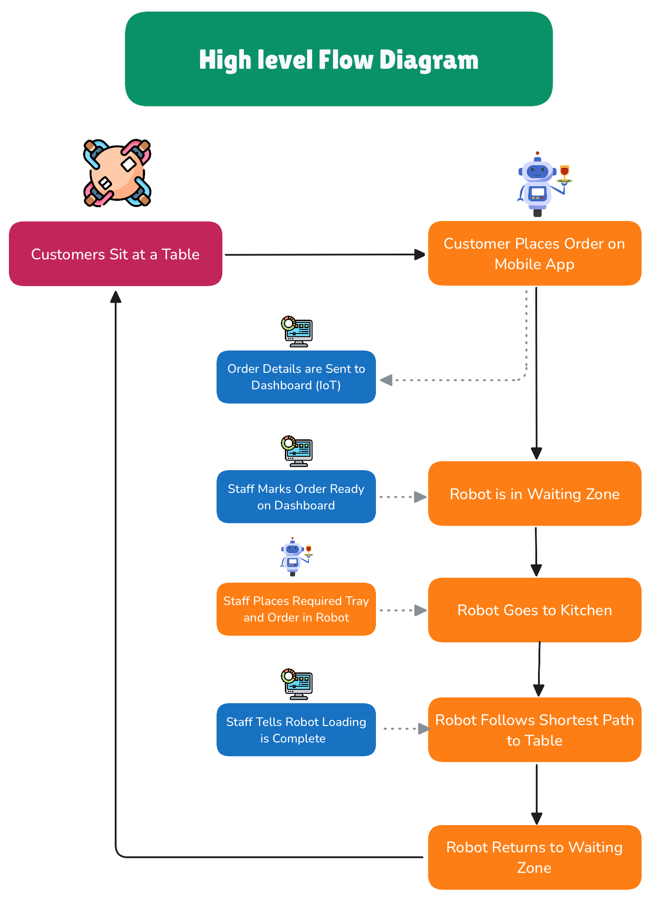

Slide 8
Mechanical
Hardware

Slide 9
Design Considerations
^{Based off Existing Designs}
1
Design Factors Include Material availability, Safety, Cost, Strength/Load Carrying Capacity, Weight, Ease of Assembly and Aesthetics
2
Mechanical Simulations on ANSYS to Determine Materials & Parameters for Load Carrying or High Stress Parts
3
Modular Custom Parts and In House Fabrication & Assembly
4

Slide 10
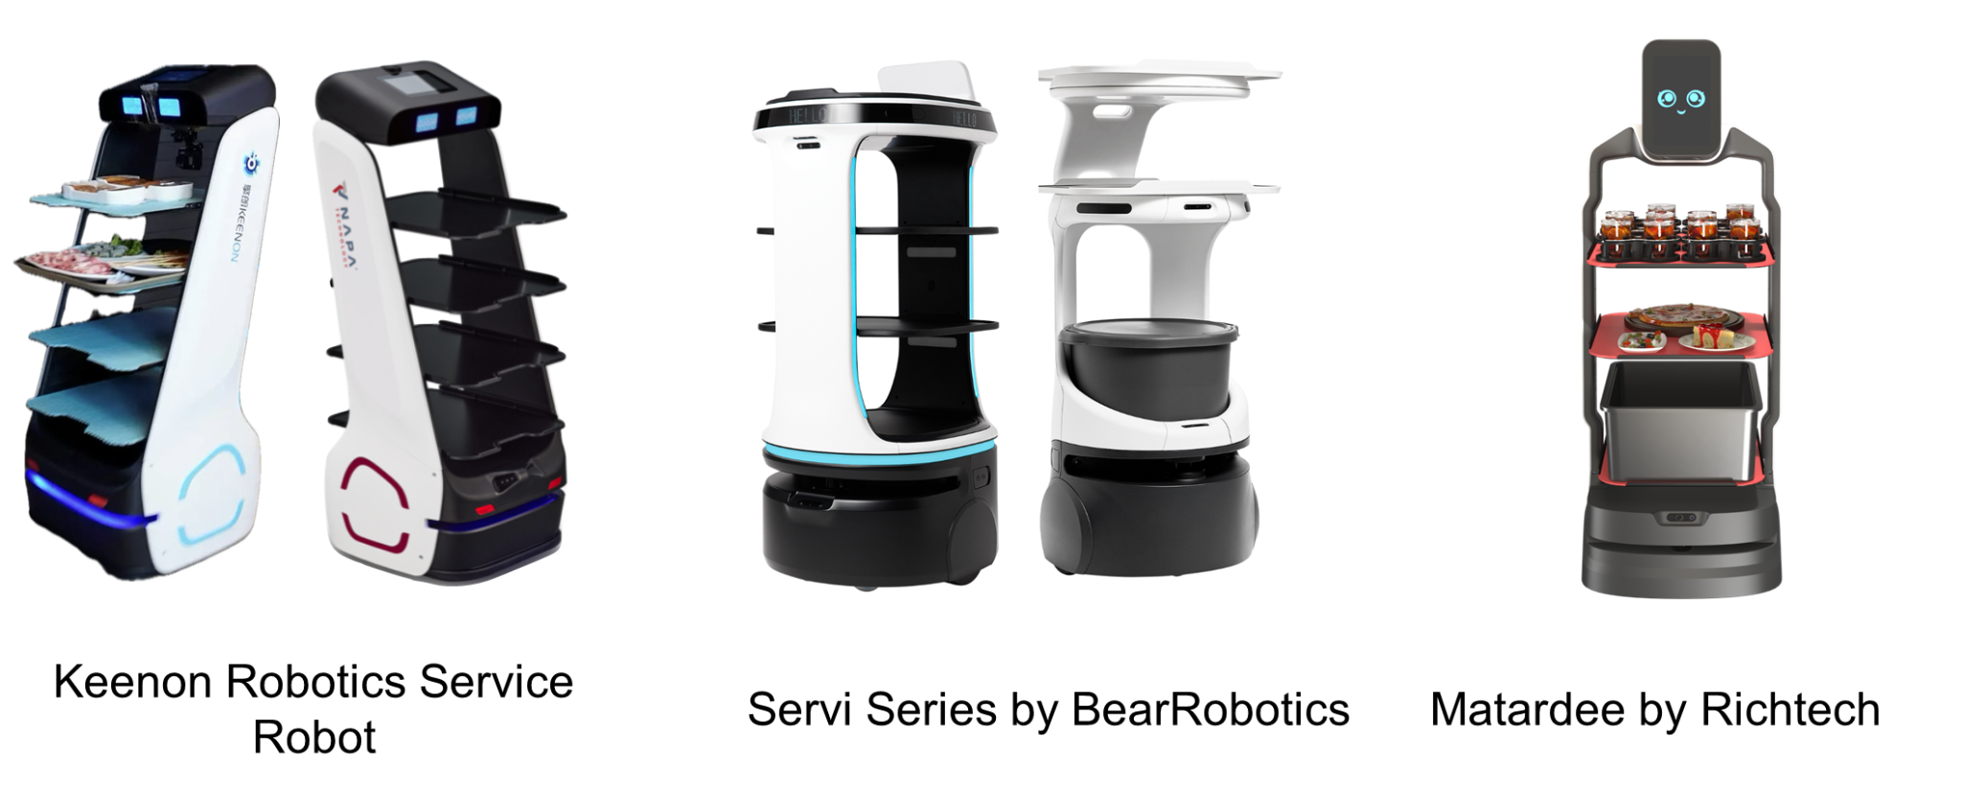
Existing Designs

Slide 11
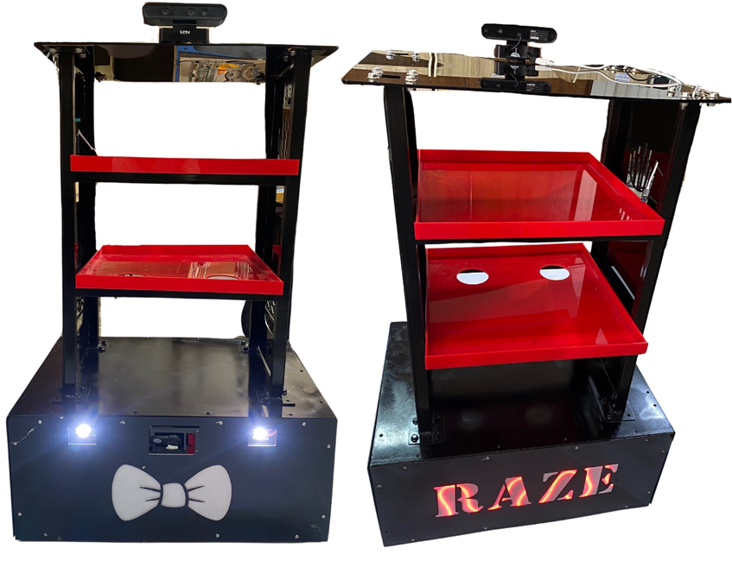
Our Design

Slide 12
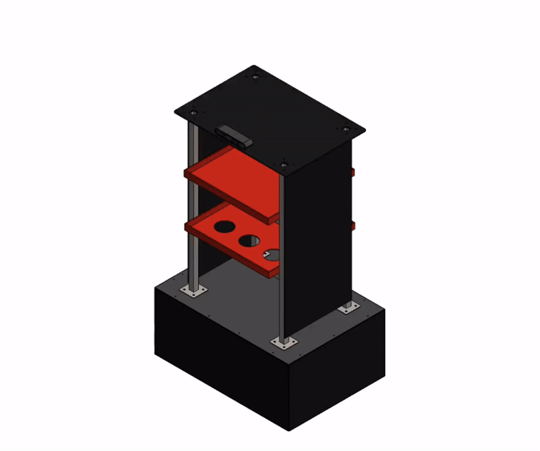
Design Breakdown

Slide 13
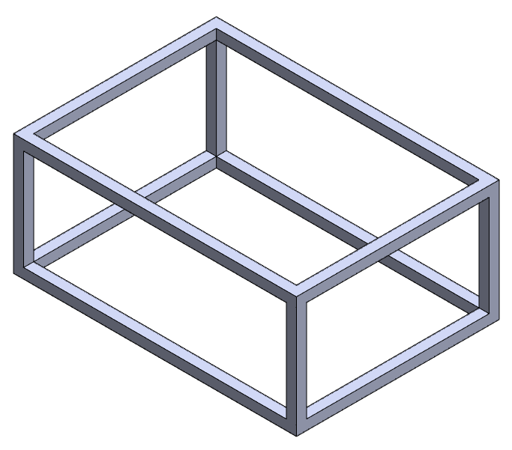
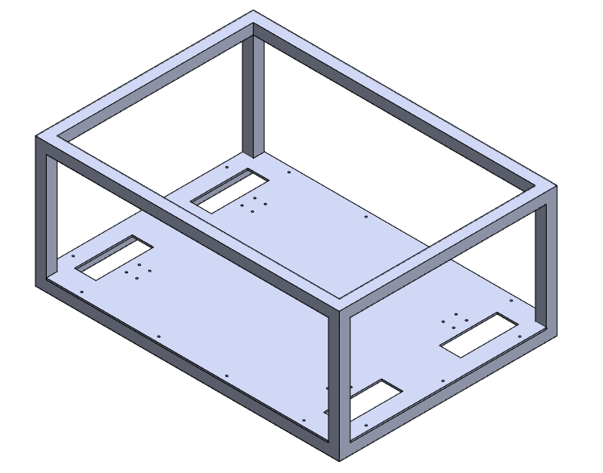
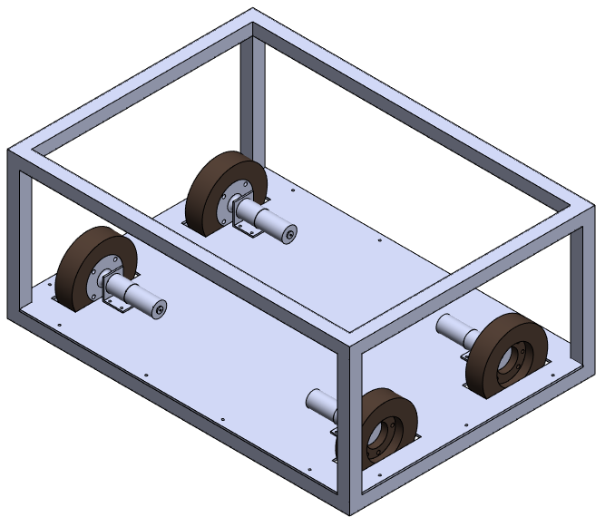
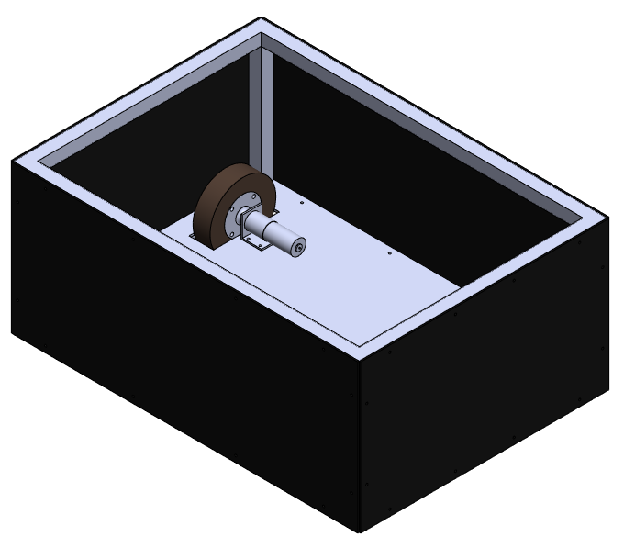
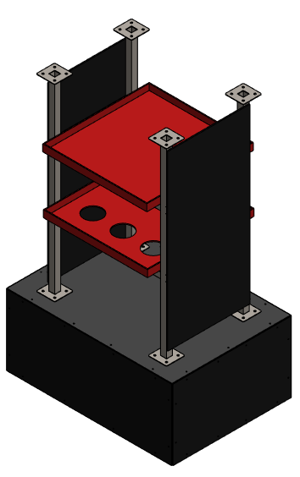
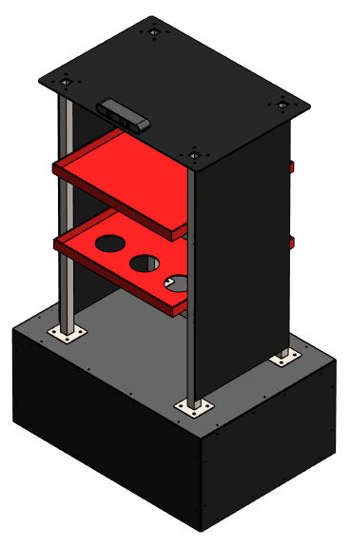
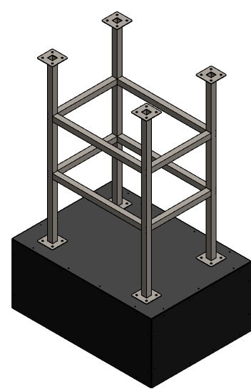
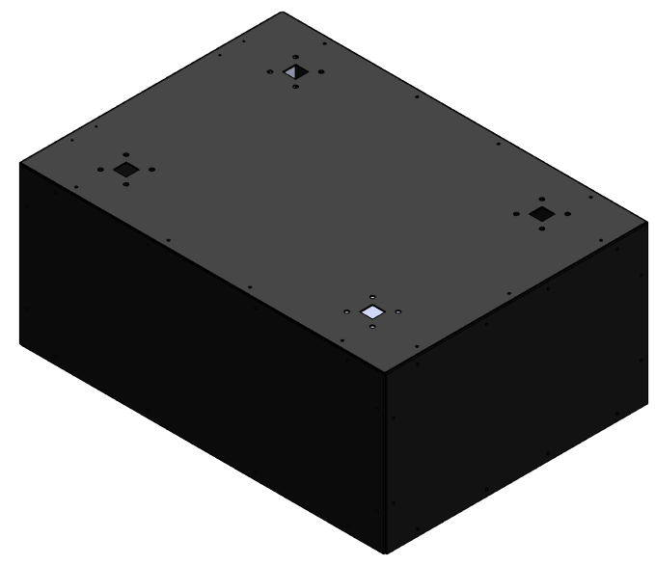

Slide 14

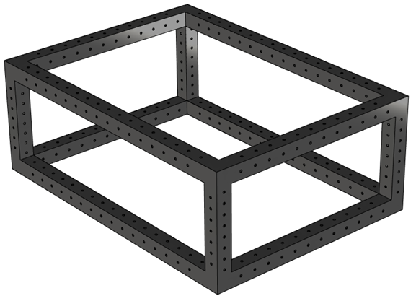
Frame and Baseplate

Slide 15
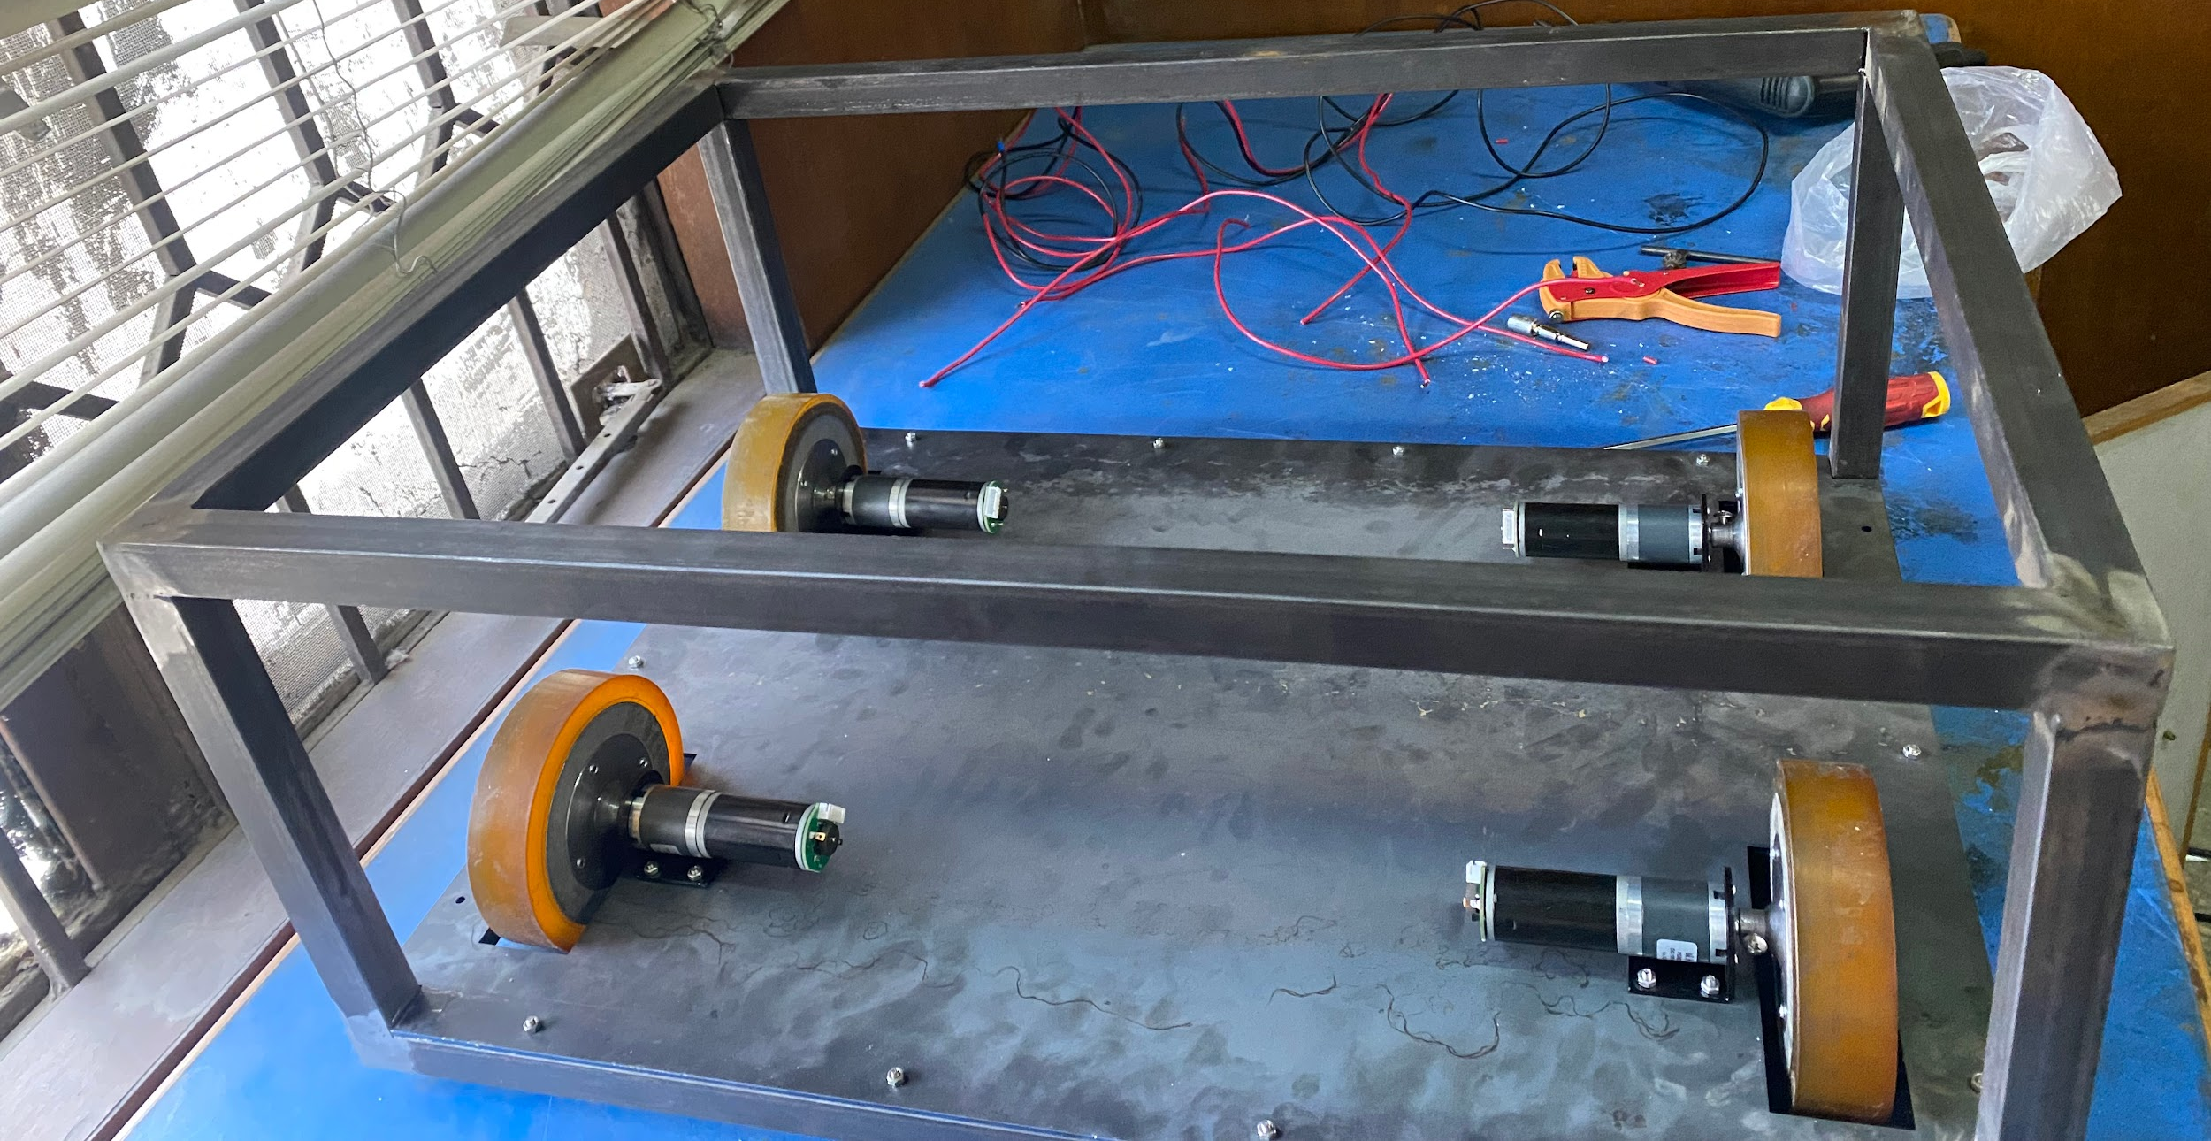
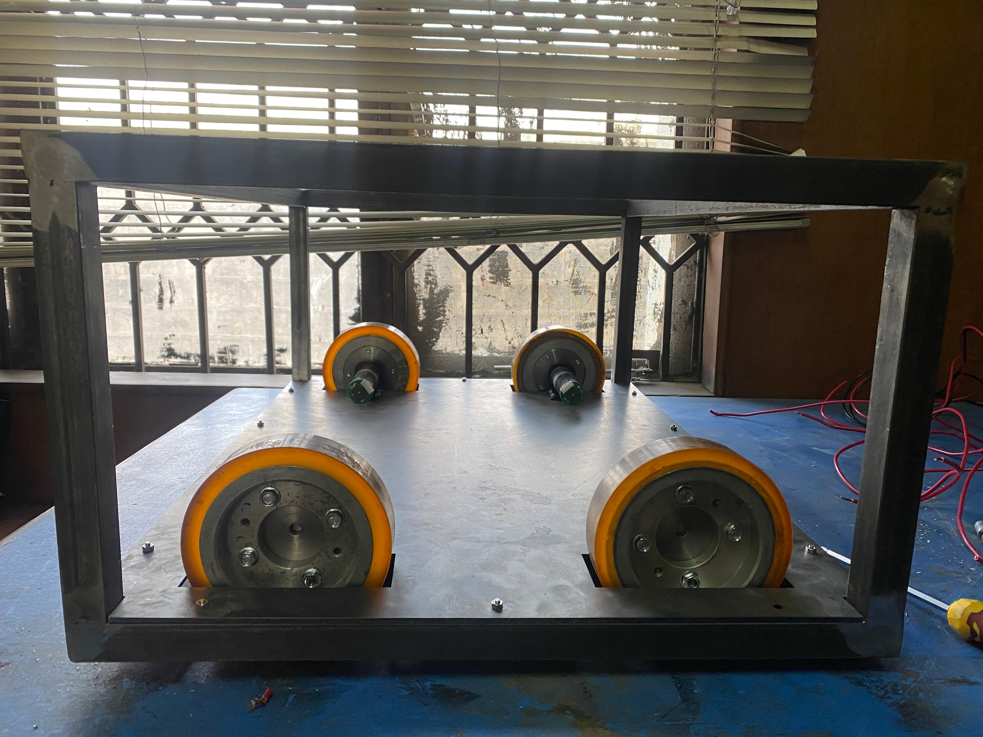
Frame and Baseplate

Slide 16
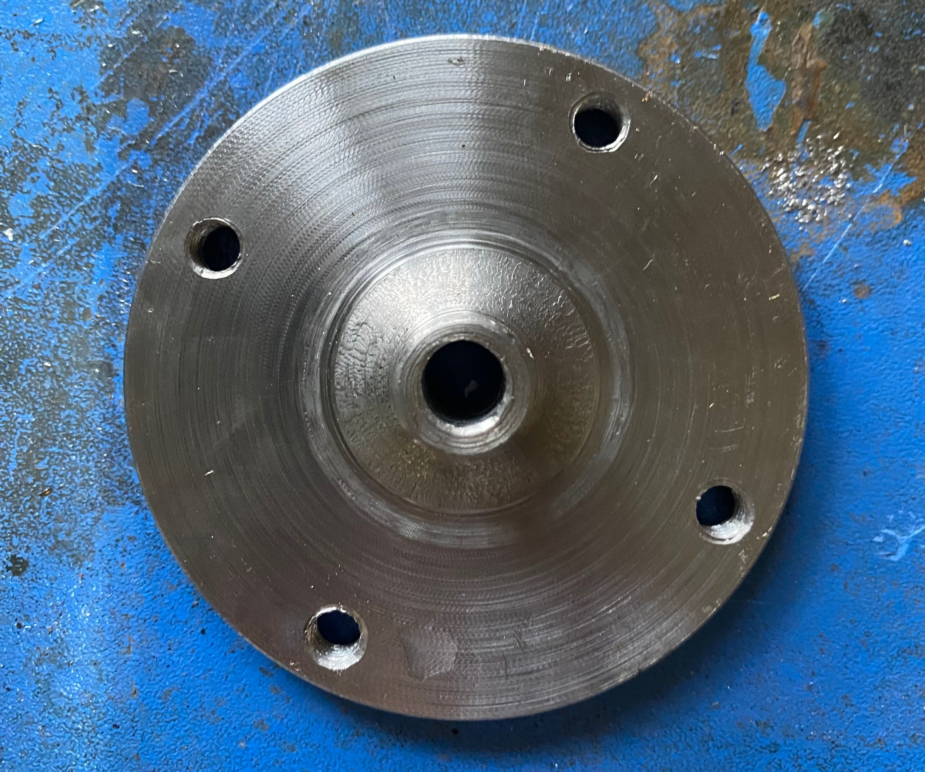
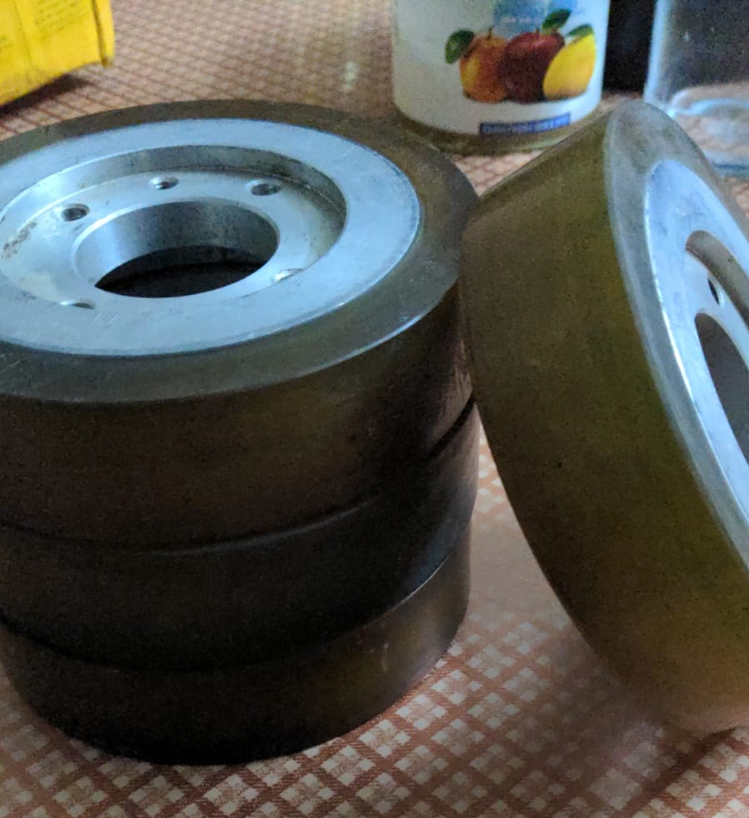
Couplers and Wheels

Slide 17
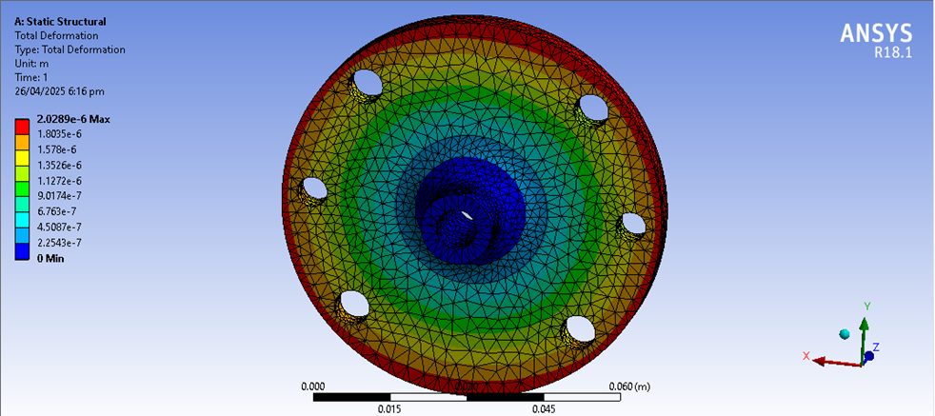
Coupler Deformation

Slide 18
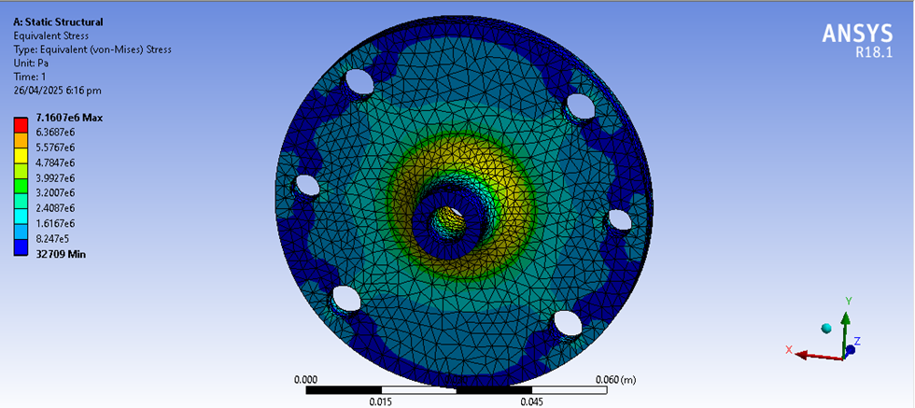
Coupler Stress

Slide 19
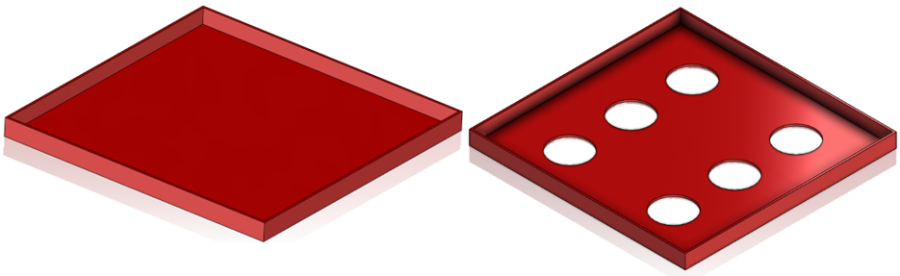
Load Trays

Slide 20
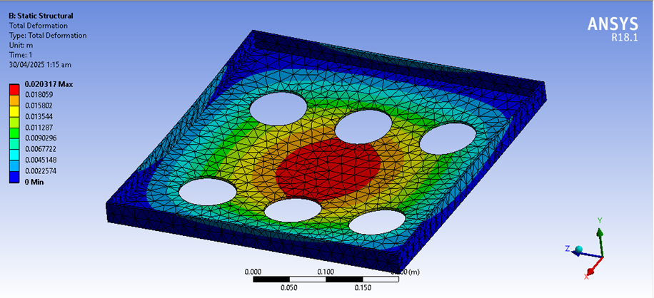
Load Trays Deformation

Slide 21
Electrical
Hardware

Slide 22
Electrical Design Highlights
Electronics are Mostly off the Shelf Components; Easy access and Replacement
1
Selection & Acquisition of Electrical Hardware was done on the Basis of Mechanical Requirements
2
Electrical Safety, Redundancy & Modularity Ensured
3
Dual Batteries With Built-in Charger & Charge Indicator
4

Slide 23
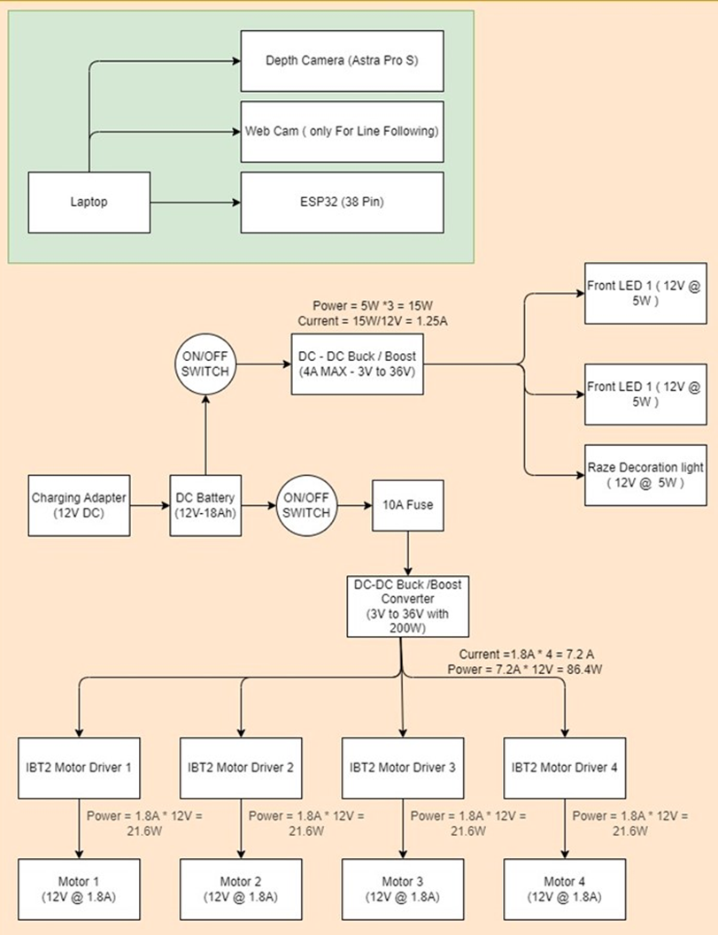
Wiring Layout

Slide 24
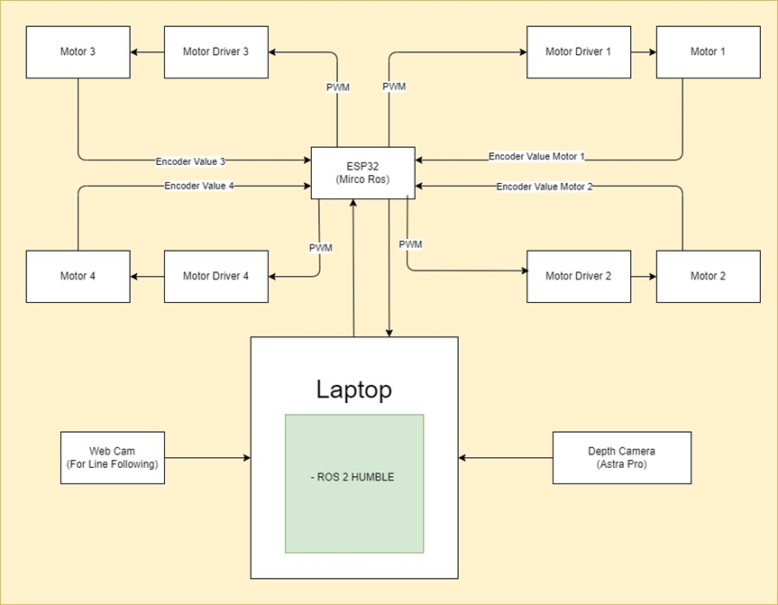
Connections Layout

Slide 25
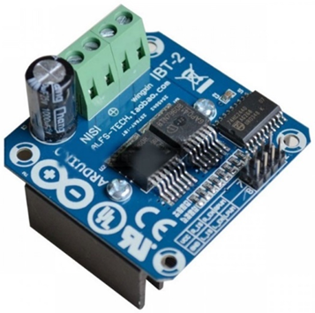
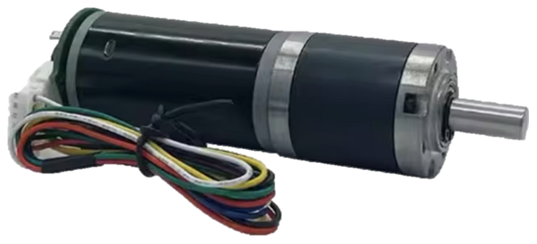
Motors and Drivers
Reduction Ratio | No Load Ratings |  |  | Loaded Ratings |  |  |  | Stall Ratings
 | Voltage | Speed | Current | Speed | Current | Torque | Power | Torque | Current
71 | 12 V | 112 RPM | 0.45 A | 90 RPM | 1.8 A | 10 kg cm | 21.6 W | 33 kg cm | 5 A

Slide 26
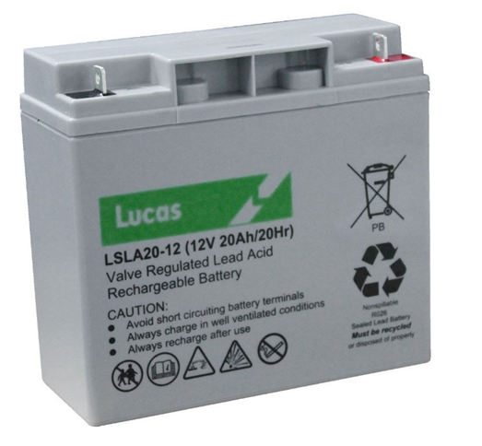
Batteries
Voltage | Capacity | Max Current | Battery Timing | Charge Time
12 V | 28 + 3 Ah | 20A | 6-10 Hours | 4 Hours

Slide 27
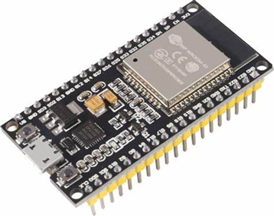
Controller
Controller | Clock Speed | Voltage | GPIO Pins | Analog Inputs | PWM Pins | UART / I2C / SPI | Wi-Fi | Bluetooth | Flash Memory | RAM | USB Interface | Price (Approx.)
Dual-core Tensilica LX6 | Up to 240 MHz | 3.3V | 34 | 18 (12-bit ADC) | Most GPIOs | 3 / 2 / 4 | Yes | Yes | 4MB (external) | ~520KB SRAM | Micro USB | $5–10

Slide 28
Feature | ESP32 NodeMCU | Arduino Uno | Arduino Mega | RPi Pico
Microcontroller | Dual-core Tensilica LX6 | ATmega328P | ATmega2560 | Dual-core ARM Cortex-M0+
Clock Speed | Up to 240 MHz | 16 MHz | 16 MHz | 133 MHz
Voltage | 3.3V | 5V | 5V | 3.3V
GPIO Pins | 34 | 14 (6 PWM) | 54 (15 PWM) | 26
Analog Inputs | 18 (12-bit ADC) | 6 (10-bit ADC) | 16 (10-bit ADC) | 3 (12-bit ADC)
PWM Pins | Most GPIOs | 6 | 15 | All GPIOs
UART / I2C / SPI | 3 / 2 / 4 | 1 / 1 / 1 | 4 / 1 / 1 | 2 / 2 / 2
Wi-Fi | Yes | No | No | No
Bluetooth | Yes | No | No | No
Flash Memory | 4MB (external) | 32KB | 256KB | 2MB
RAM | ~520KB SRAM | 2KB | 8KB | 264KB
USB Interface | Micro USB | USB-B | USB-B | Micro USB
Price (Approx.) | $5–10 | $10–20 | $25–35 | $4–8

Slide 29
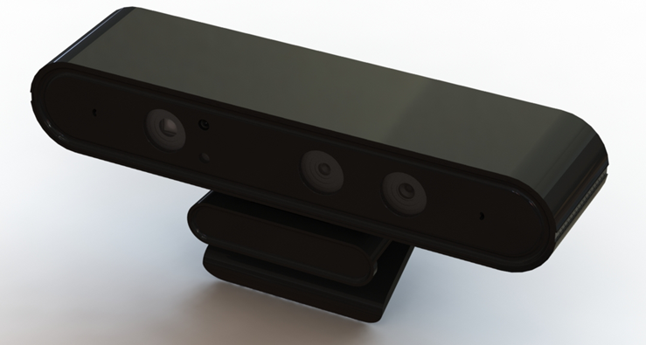
Camera
Depth Sensing Range | Depth Resolution | RGB Resolution | FoV | Operating Systems | SDK Support
0.6 to 8 meters | 640×480 at 30 FPS | 1280×720 at 30 FPS | 60° horizontal × 49.5° vertical × 73° diagonal | Windows, Linux, Android | OpenNI, Astra SDK, ROS.

Slide 30
Ecosystem Applications

Slide 31
Ecosystem Highlights
1
A System of Supporting Flutter Apps Built around the Robot to act as VaS
2
An Ordering App That Can be Installed on Customers’ Phones, Tablets or Used Directly from the Robot
3
A Dashboard App Installed in the Kitchen and Cashier Stations; Allows for tracking of Orders and their Updating their Statuses
A Remote Control App That Allows Manual Control Over the Robot from a Device by Authorized Users
4
Databases that Allow Restaurants to Digitize their Menus and Collect Valuable Customer Data & Trends
5

Slide 32
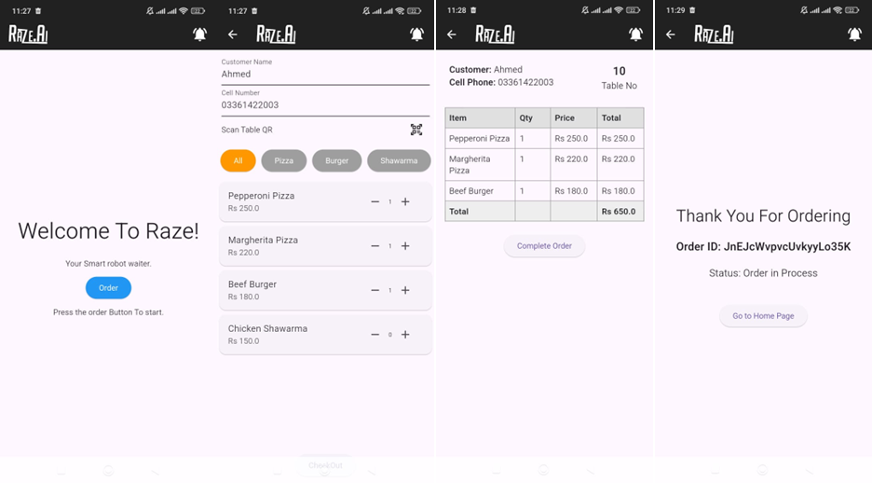
Ordering App

Slide 33

Ordering App

Slide 34
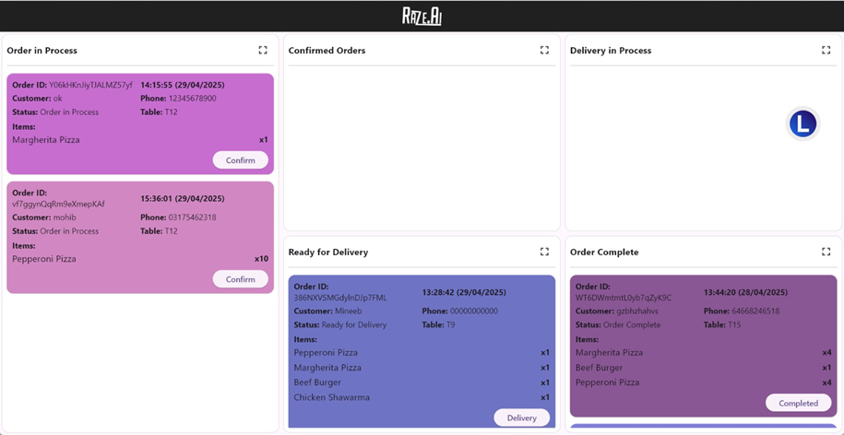
Dashboard App

Slide 35
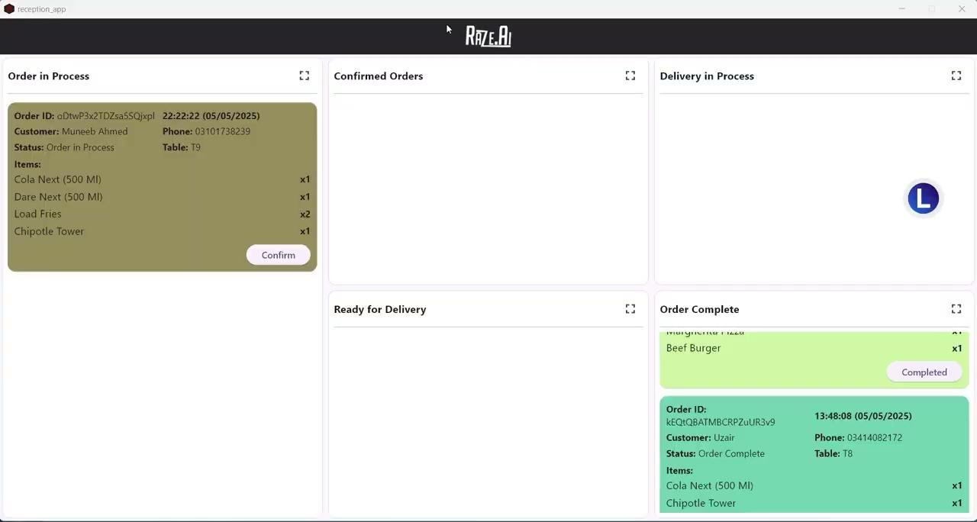
Dashboard App

Slide 36
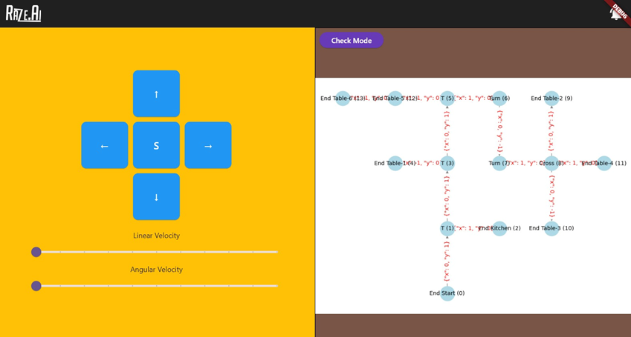
Remote Control App

Slide 37
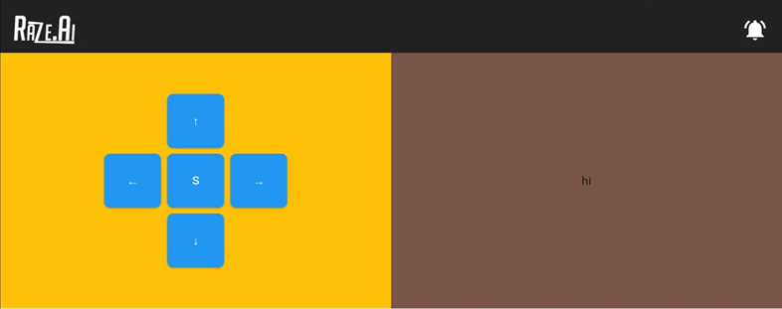
Remote Control App
Webcam Feed

Slide 38
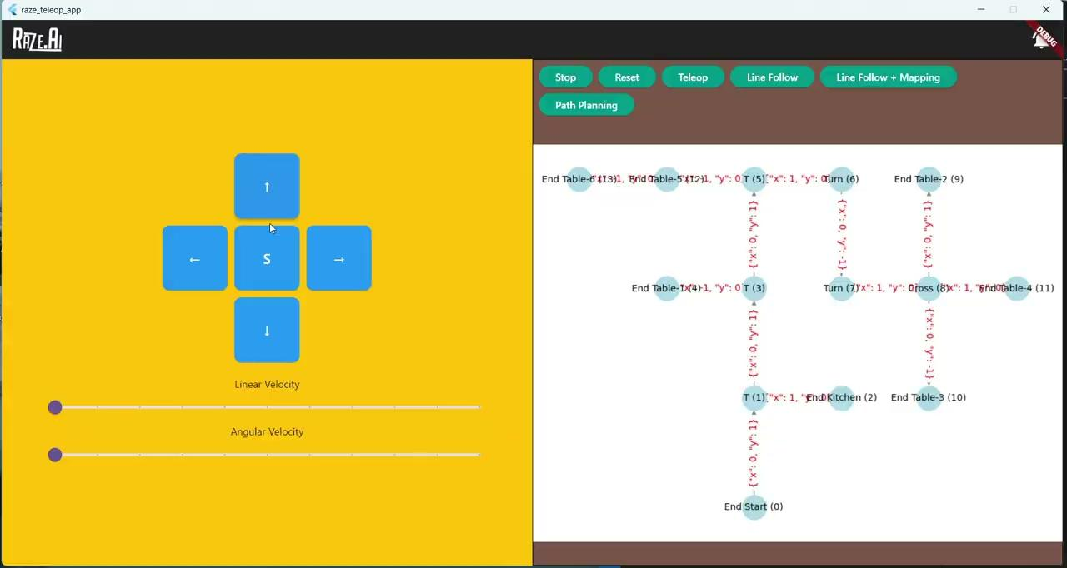
RC App Video
Webcam Feed

Slide 39
Simulations & Navigation

Slide 40
URDF & Kinematics
Created URDF Files from CAD Model, Calculated Forward & Inverse Kinematics of the Robot
1
Simulated and integrated the Robot, Environment and Cameras in Gazebo Using ROS2 and the Kinematics
2
Simulation First Approach Allowed for Easy Debugging and Testing Before Robot was Even Assembled
3

Slide 41
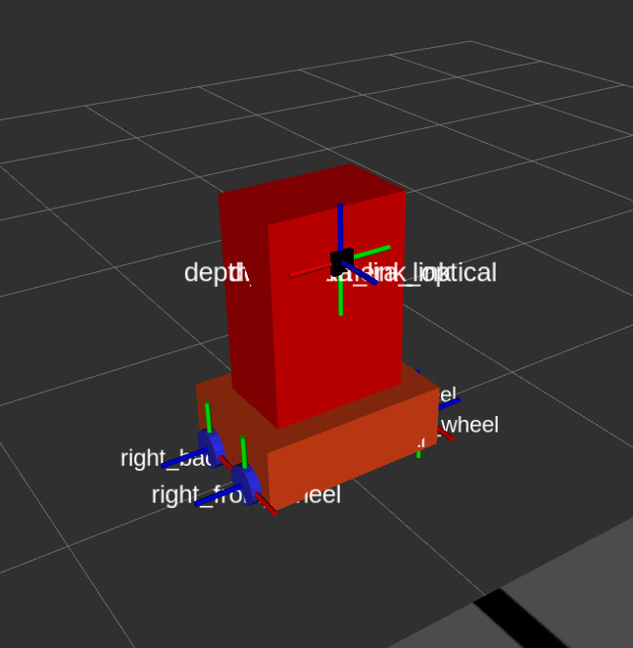
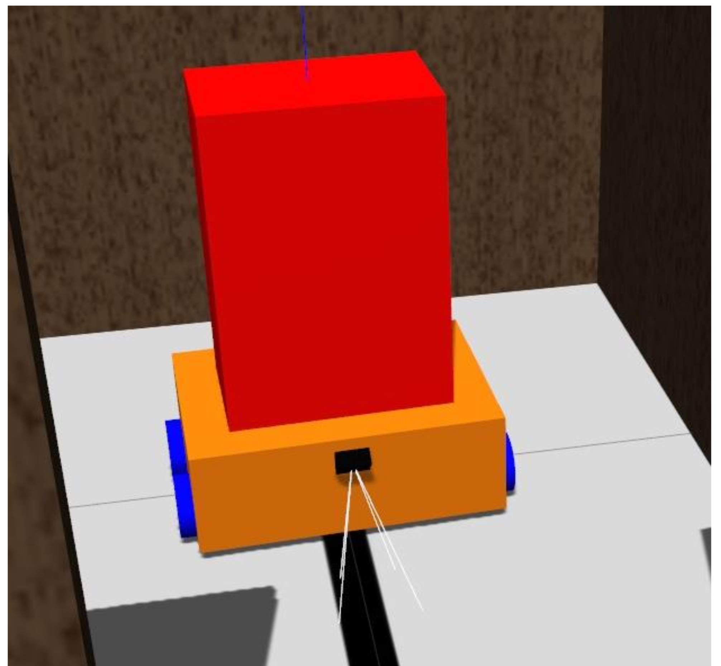
Robot Model Using URDF & Kinematics

Slide 42
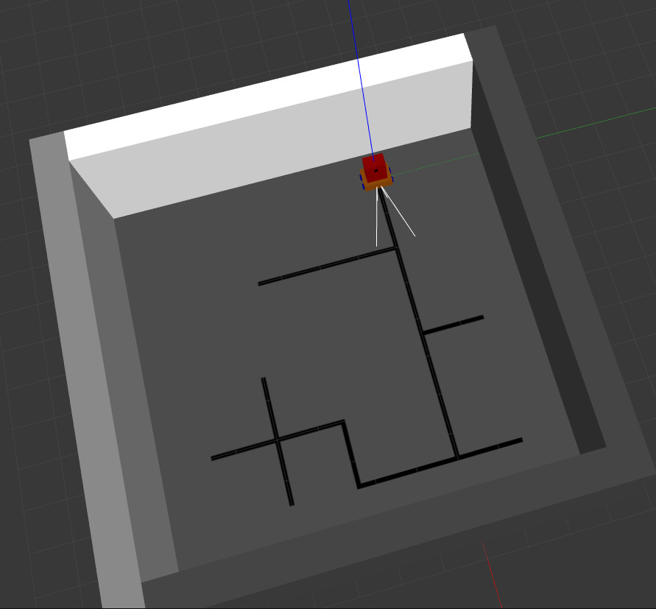
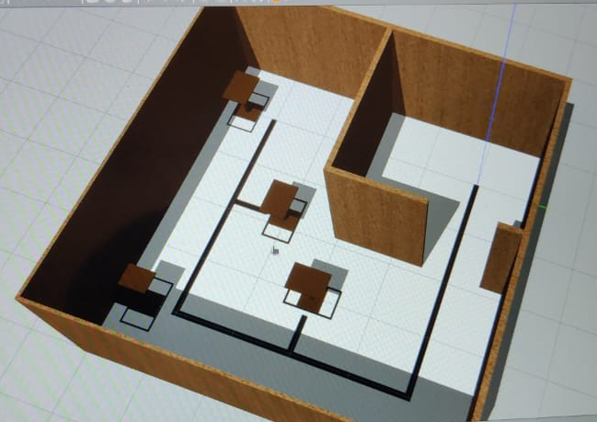
Modeling the Environment

Slide 43
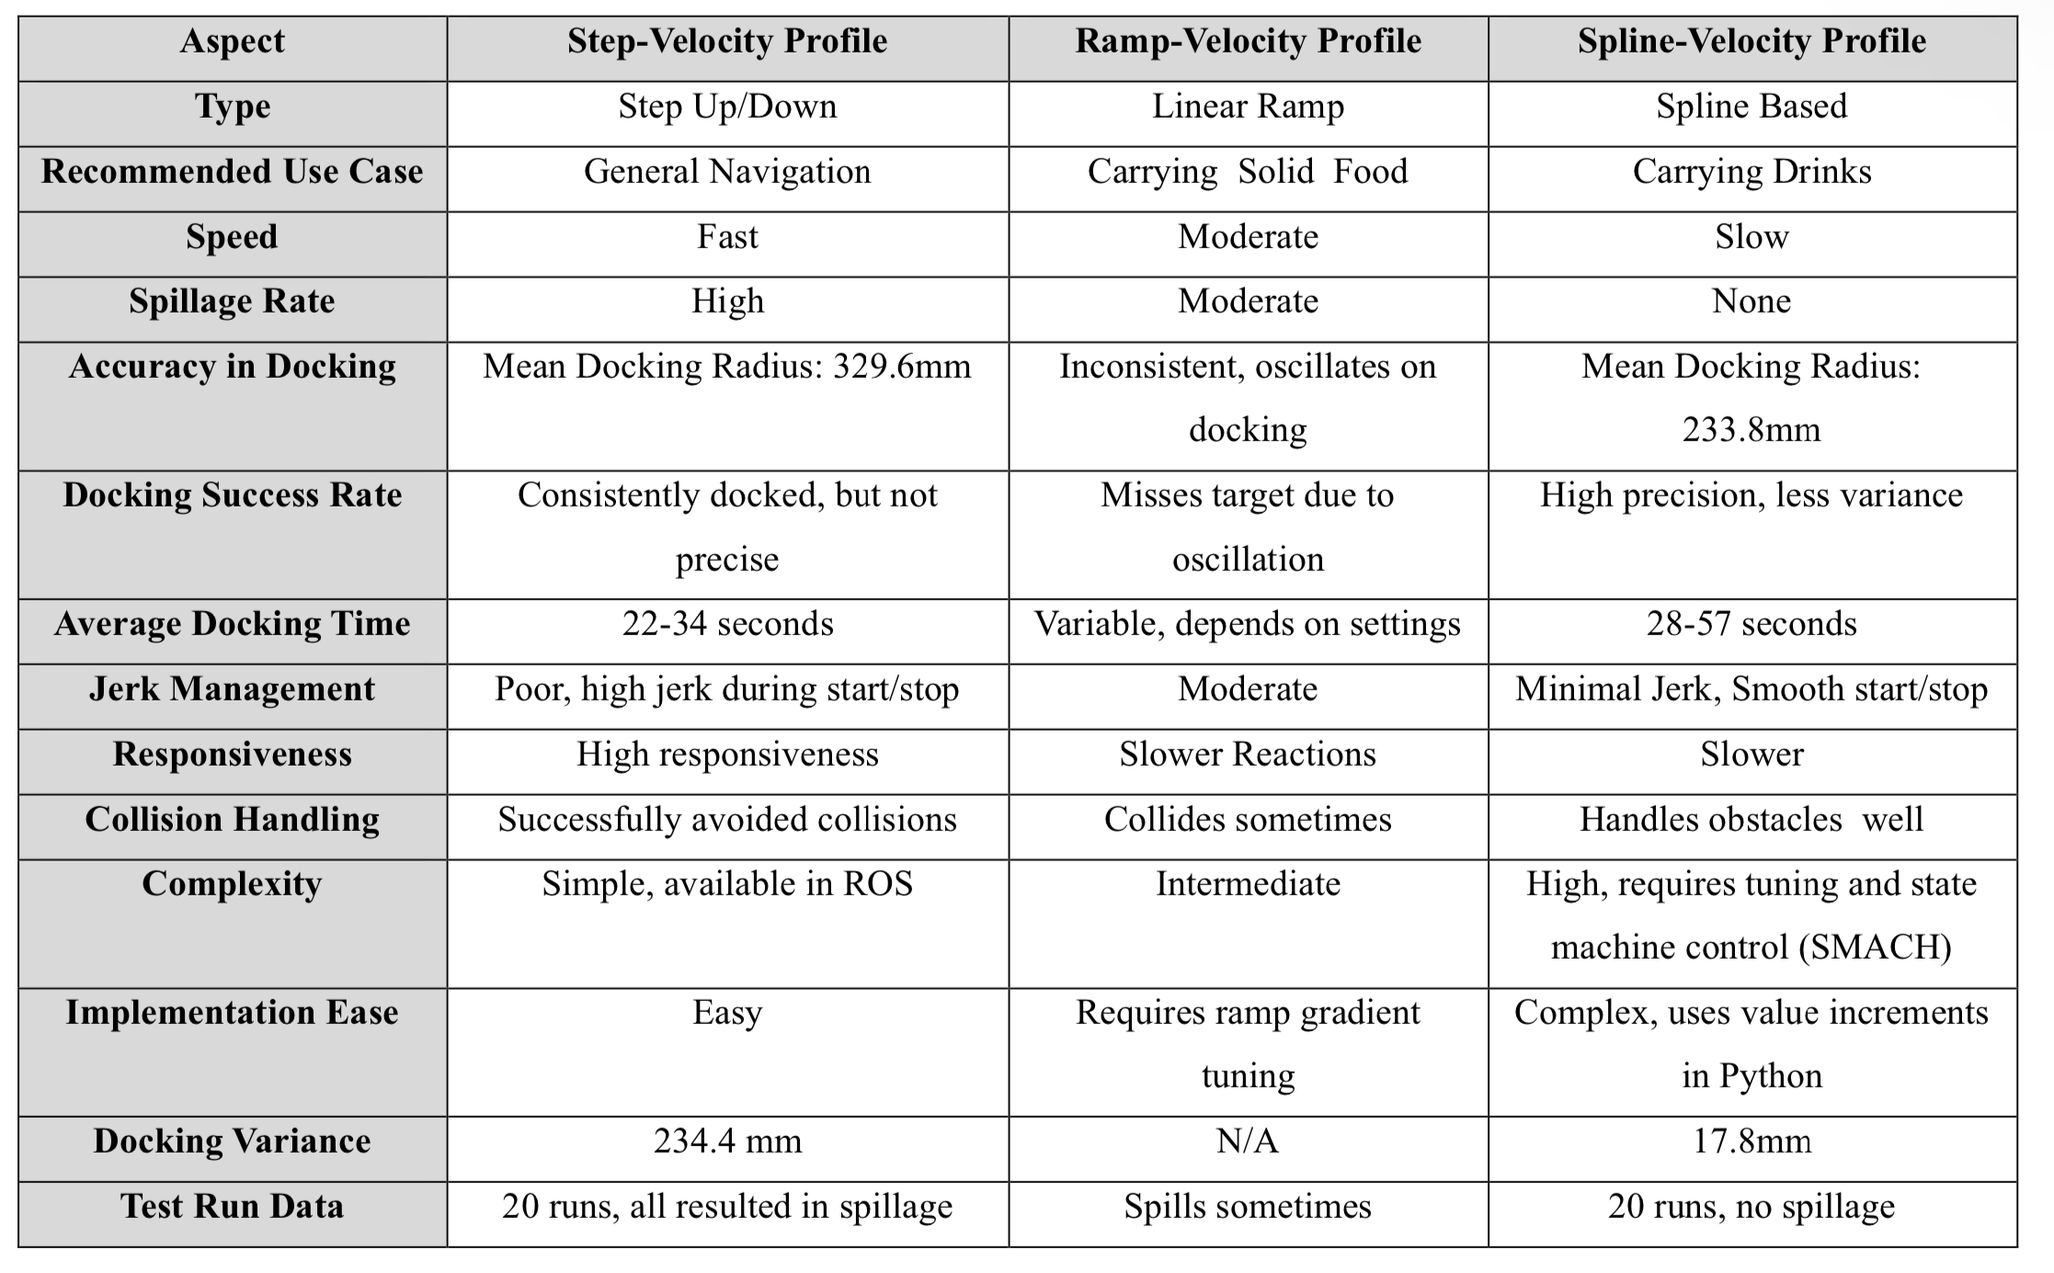
Velocity Profiles

Slide 44
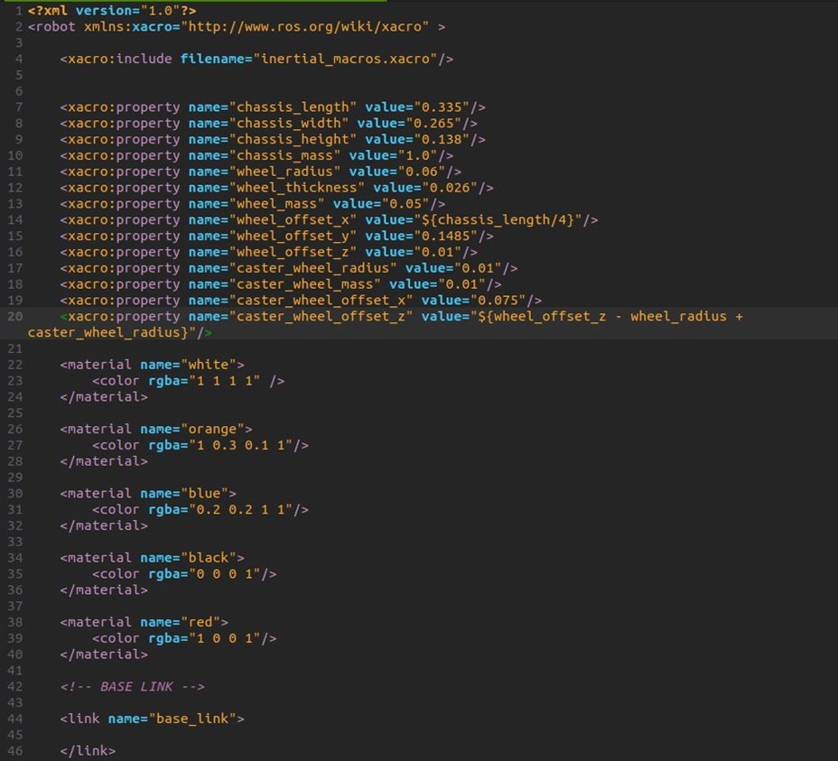
URDF Code

Slide 45
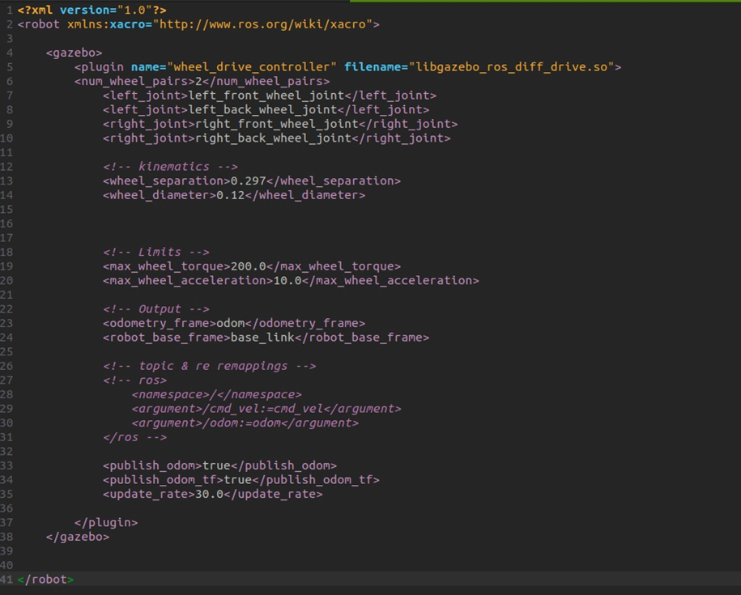
Kinematics Code

Slide 46
Navigation
Created a Robust Line Identification and Tracking Algorithm Using OpenCV
1
Performed Junction Classification Using ArUco Markers
2
Created a Mapping and Path Planning Algorithm
3
Used Depth Camera to Detect Obstacles and Avoid Collisions
4

Slide 47
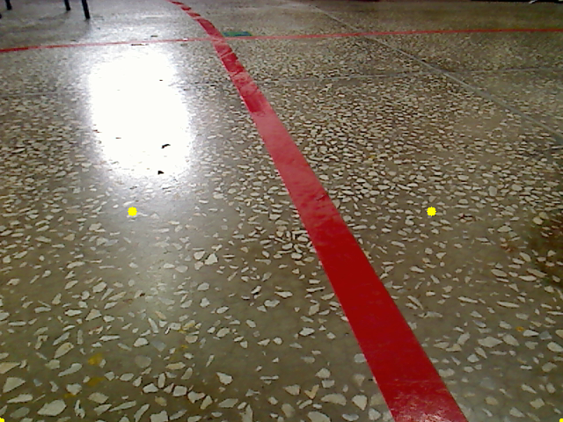
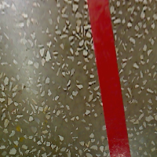
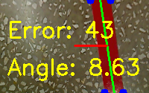
Line Following Algorithm

Slide 48

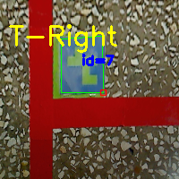
Junction Classification

Slide 49
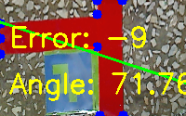
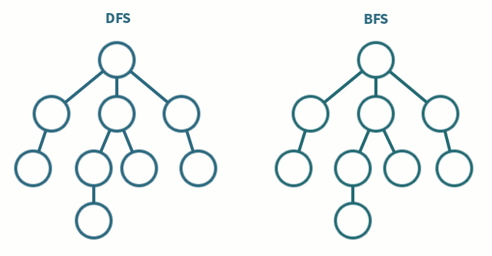
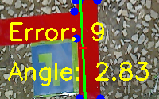

Mapping & Path Planning

Slide 50

Collision Avoidance

Slide 51



Line Identification

Slide 52


Junction Identification

Slide 53

Line Map

Slide 54
Results &
Conclusions

Slide 55
Testing Results
 | No. of Tests in Final Configuration | Successful Runs (Navigated & Delivered) | Partial Failures |  | Failed Runs
 |  |  | Navigated but did not deliver | Delivered but did not navigate
With Only Food | 10 | 9 | 0 | 1 | 0
With Only Drinks | 10 | 9 | 1 | 0 | 0
With Food & Drinks | 10 | 10 | 0 | 0 | 0
Total | 30 | 28 (93.33%) | 1 | 1 | 0

Slide 56
Limitations
Scope Constraints; Lack of Realistic Testing Environment & Dependance On Structured Environment
1
Component Availability & Cost Issues, Delivery Issues from Foreign Suppliers
2
Hesitation to Testing & Adoption, Especially by Local Restaurant Owners
3
Lack of Long Term Performance Data (Customer Trends, Battery Data, Wear & Tear Data)
4

Slide 57
Future Work
Transition To Full Autonomy Via SLAM
1
Real Time Path Re-Planning & Dynamic Obstacle Avoidance
2
Multi Robot Integration & Fleet Management Operations
3
Design Optimizations; Charging Dock, PoS Integration, Moveable Trays, Voice Commands, Advanced UI & Language Support
4

Slide 58
Thank You

Slide 59
Questions?

